Slide 1

How is Cheltenham Festivals developing Adaptive Resilience?
What is it?
What are we doing at Cheltenham Festivals?
Has any of it helped?
Andrew Lansley
Cheltenham Festivals

Slide 2
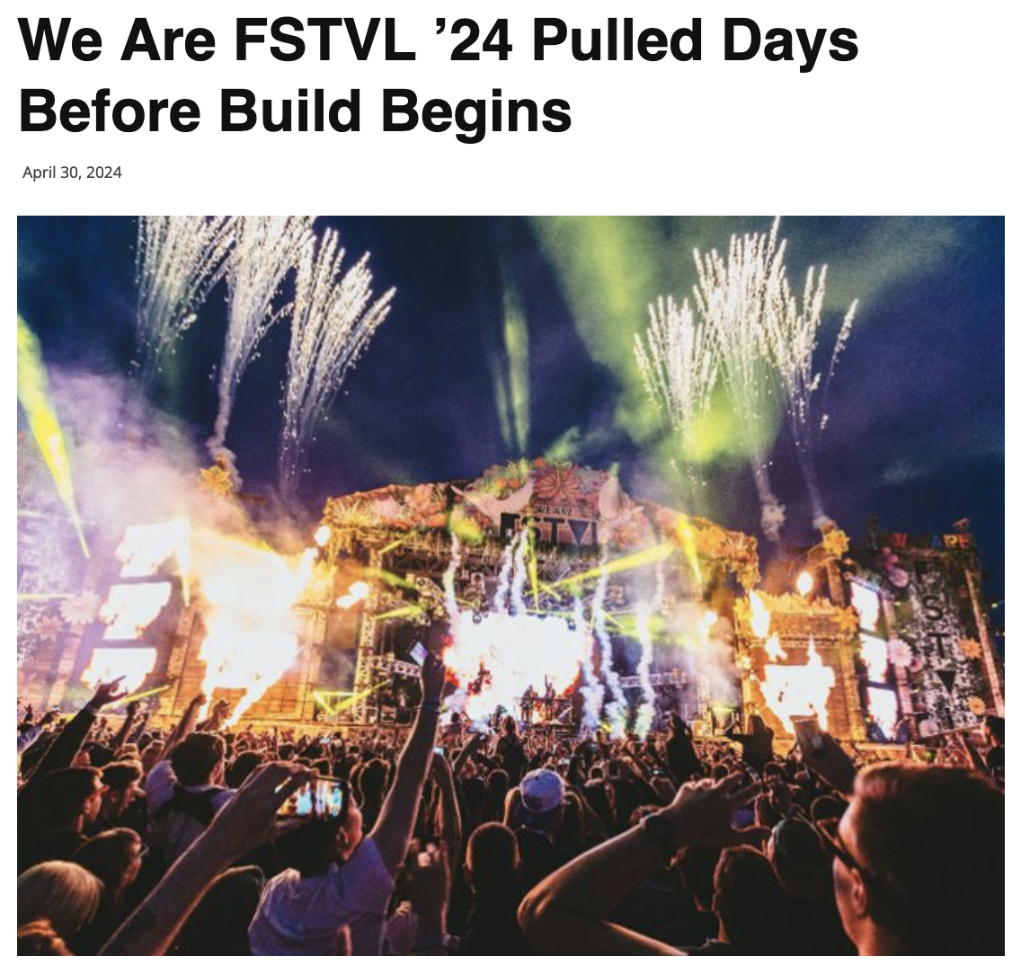
What is Adaptive Resilience?
“The world is already experiencing changes in average temperature, shifts in the seasons, an increasing frequency of extreme weather events, and slow onset events. The faster the climate changes and the longer adaptation efforts are put off, the more difficult and expensive responding to climate change will be.”
UN Climate Change₍₁₎
“In the UK we’re already seeing hotter summers, warmer wetter winters and increased weather extremes. These changes are affecting our health, food security, and ecosystems… (and) serves as a glimpse into a future without climate adaptation.”
Julie’s Bicycle₍₂₎
Climate change is upon us and with figures from US Geological Survey₍₃₎ showing a 320% increase in storms since 2010, evidence suggests a strategic – and urgent - response is required in order to prepare organisations for environmental impacts that are already predicted to influence the way they need to plan and prepare for the future.

Slide 3
Why are Cheltenham Festivals developing an Adaptive Resilience strategy?
Cheltenham Festival’s Sustainability Strategy includes scope to audit and adapt to progressive frameworks and practice to build a response to the ongoing climate crisis. Engagement in emerging pilots and programs (such as the GECOP pilot project₍₄₎ and CC Tools₍₅₎ has helped to keep Cheltenham Festivals involved with key organisations and latest developments within the sector, guiding our strategic planning as it adapts.
To understand the local context of this challenge further, we explored weather data aligned with our event delivery and identified the following trend, which suggests we have experienced an increase in temperature ranges across our festivals since 2021:
 | 2021 | 2022 | 2023
Jazz | Lo 6 / Hi 15 (9)* | Lo 7 / Hi 17 (10) | Lo 8 / Hi 20 (12)
Science | Lo 19 / Hi 28 (9)* | Lo 14 / Hi 23 (9) | Lo 8 / Hi 27 (19)
Music | Lo 15 / Hi 23 (8) | Lo 15 / Hi 27 (12) | Lo 10 / Hi 22 (12)
Literature | Lo 7 / Hi 19 (12) | Lo 3 / Hi 17 (14) | Lo 2 / Hi 22 (20)
Mean Range Hi/Lo | ±9.5°C | ±11.25°C | ±15.75°C

Slide 4
How are we addressing adaptation through our activities?
We are adopting processes within our three-year sustainability strategy₍₉₎ that will help to re-evaluate event planning with climate resilience in mind – expanding “beyond wet weather” plans. These will be drawn together from departments across our organisations to consider the environmental impact of transportation, logistics, and site construction. This will run in parallel to the reuse and regeneration elements of strategy, to ensure we consider impacts from adaptive processes to minimise any further impacts.
Some of our plans include:
Reviewing our infrastructure onsite e.g. The Maze at Science Festival was outdoors, and subject to the elements. We are looking to create new training materials for severe weather protocols including heatwaves and storms.
We are exploring adaptable structures and pathways that can be deployed in extreme weather context: e.g. storms, lightning, that are also accessible.
During delivery of our summer events (i.e. Science Festival) the weather is generally warmer, so we are looking at how to protect venues/marquees against growing temperature variations. This is difficult in the face of a lack of regulations for maximum working temperatures in the UK; we’re creating internal standards for a heat stress policy (times, temps, water and creams)
We will be looking to work with our local authority (Cheltenham Borough Council) to look at drainage infrastructure, and how the impact of venue builds on green spaces can create addition impacts beyond run off.
We are looking to scope unseen onward impacts on infrastructure that might be caused by last minute adjustments/procurement emergencies and efficiencies.
Opting for temporary and sustainable materials in venue design.
Integrating adaptive related climate themes into programs to foster awareness and action.

Slide 5
How are we addressing adaptation through our activities?
We are exploring themes around existing practice so we are ‘changing the tyre’ rather than reinventing the wheel:
Digital Transformation and Virtual Engagement
We are continuing our research into digital technologies, not just to expand virtual engagement and reduce the carbon footprint associated with physical events, but to explore alternative formats that could be part of a permanent solution to deliver flexible, adaptable event formats. Although an extreme interpretation, we should consider what would happen if participants or audiences could no longer travel to events, or the traditional event format needed significant revisions in the face of emergency measures or legislation that may be required in future. As such we have taken the concept of virtual events ‘back to line’ in how we might source, produce and broadcast events, online educational programs and create digital resources and XR environments.
Resilience through community partnerships
We are already collaborating with local community groups, environmental organisations, and councils to share knowledge, resources, and best practices in adapting to climate impacts. We have formed initiatives (such as the Cheltenham Donut Project) and joined partnership (such as Cheltenham Zero) to develop and implement joint activities addressing climate resilience and sustainability, with accessibility as a particular focus. We are also looking to innovate, and currently investigating an “Accessible Library of Things” shared between all venues and events/festivals in Cheltenham that is centrally coordinated. This will improve accessibility to events and venues around town, save road miles on logistics and hopefully cost everyone less money. We are working hard to share case studies and insights as we implement and develop this work, and believe a localised approach presents both a sustainable and resilient model for adapted resource and operations.
Sustainable Practices and Infrastructure
Sustainable practices are already embedded from strategic planning to daily operations and our events, in line with an industry formed set of standards. This includes reducing energy consumption, waste, and water usage in line with GECOP standards. We have invested in energy-efficient technologies and infrastructure, such as HVO, green-site electrification and efficient heating, ventilation, and air conditioning (HVAC) systems. One of the best ways we believe we can build an adaptive strategy is to proactively engage, and contribute to, sector leading programmes and initiatives.
Public Awareness and Education
We want to use our platforms to raise awareness about adapting to climate change and its impacts on communities and cultural heritage: Music, Science and Literature all exist on the same planet! We need to explore how we can develop more educational programs, exhibitions, and events that highlight the importance of environmental stewardship. We want to engage audiences in discussions on climate resilience and sustainable practices, and hope this would help to build both an understanding, and a sense of responsibility for this area of environmental practice.

Slide 6
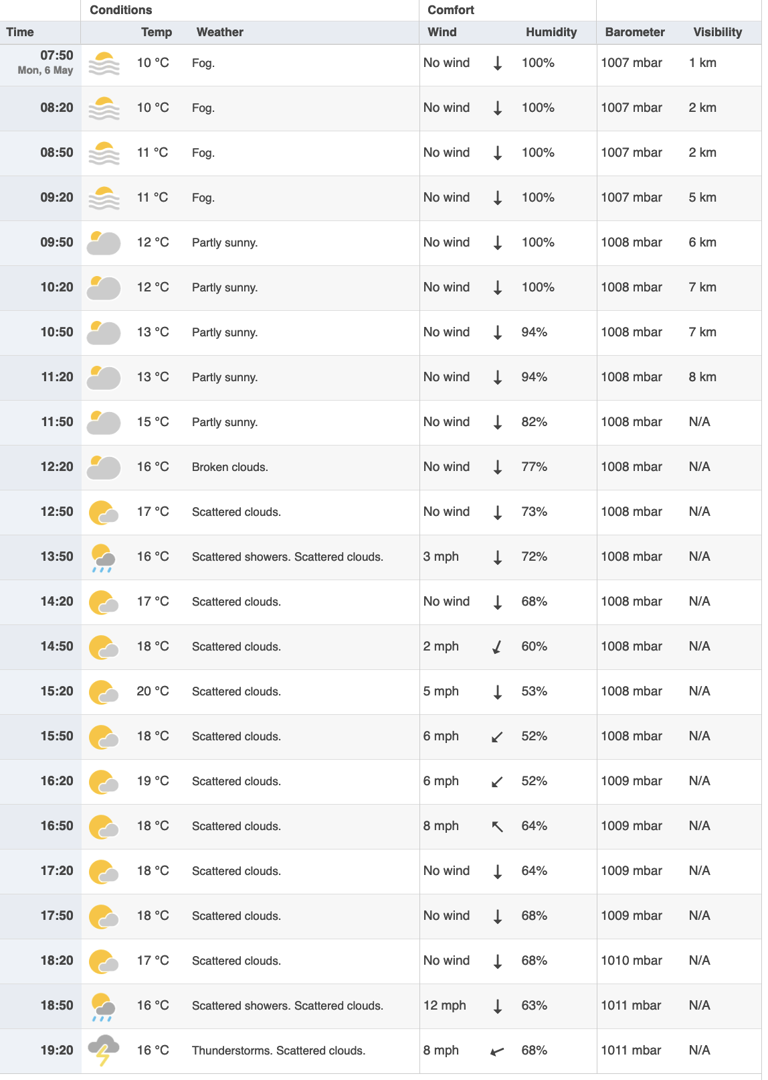
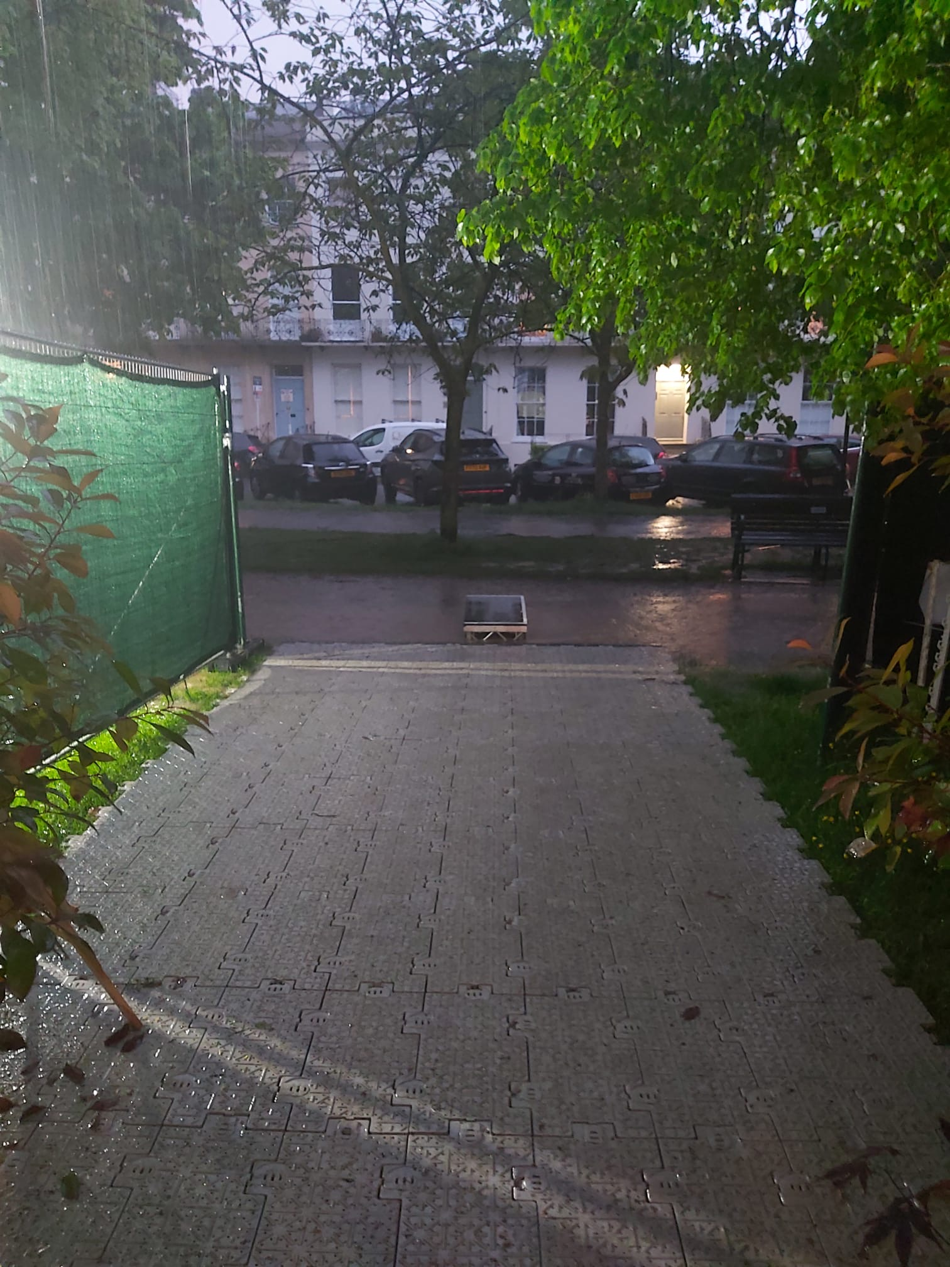
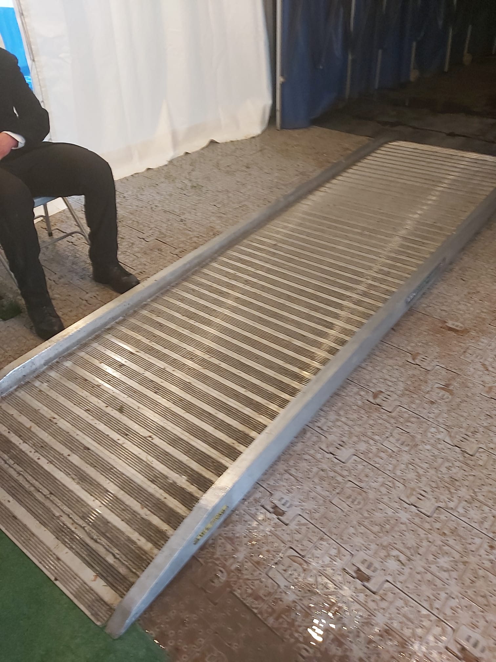
Has any of it helped?
Cheltenham Jazz Festival – May 6th 2024 // The Great Gregory Porter Downpour
Light rainfall happened here
Thunderstorm happened here
What happened?
On the final day of Cheltenham Jazz Festival 2024, during the final hour of performance our festival site experience a torrential downpour that turned an already waterlogged site into a muddy swimming pool. Due to our access infrastructure and mitigation planning we were able to minimise disruption and avoid site closure.
Access to hospitality area
(note small river forming at end of track…)
Backstage area ramped

Slide 7
References
https://unfccc.int/topics/adaptation-and-resilience/the-big-picture/introduction
https://juliesbicycle.com/news-opinion/reflections-how-can-cultural-organisations-adapt-to-climate-change/
https://www.usgs.gov/faqs/how-can-climate-change-affect-natural-disasters?qt-news_science_products=0#qt-news_science_products
https://juliesbicycle.com/news-opinion/green-events-code-of-pract/
https://juliesbicycle.com/our-work/creative-green/creative-climate-tools/
https://www.timeanddate.com/weather/uk/cheltenham/historic?month=6&year=2023
Included in Historical Data section.
Included in Historical Data section.
https://www.cheltenhamfestivals.com/green-cheltenham-festivals
https://juliesbicycle.com/news-opinion/reflections-how-can-cultural-organisations-adapt-to-climate-change/

